Slide 1


Minor Project
Title:
Virtual Try-On
Presented by:
Mouli Bhardwaj, R2142201683,CSE AIML
Nagma Siddiqui, R2142201868,CSE AIML
Om Agarwal, R2142201904, CSE AIML
Prabal Pratap singh, R2142201856, CSE AIML
Guided by:
Dr. Ajay Prasad
School of Computer Science

Slide 2
Content
Introduction
Problem Statement
Industrial uses
Basic analogy
Ideology
Building the prototype
Results and outputs
Challenges and Conclusion
References

Slide 3
Introduction
Virtual try-ons have revolutionized the way people shop for clothes, accessories, and footwear. The technology behind virtual try-ons has advanced significantly in recent years, and it's now possible to experience a realistic, true-to-life simulation of how a product would look on you.
In our virtual try-on project, we aim to provide a seamless and intuitive shopping experience for customers by incorporating cutting-edge technology and user-centered design. Our virtual try-on system will allow customers to easily try on a wide range of products, from clothing to footwear and accessories, using just a smartphone or computer webcam. With a simple, user-friendly interface and accurate product representation, our virtual try-on system will provide customers with the confidence to make informed purchase decisions.
Our project is designed to address the common challenges faced by online shoppers, such as sizing, fit, and colour accuracy. With our virtual try-on system, customers will be able to see exactly how a product fits, without the need for physical fitting rooms or trying on multiple sizes. Additionally, the use of augmented reality technology will allow customers to see the product in the context of their own environment, helping them visualize how the product will look in real life.
We believe that virtual try-ons are the future of online shopping and our project will provide customers with a more engaging, interactive, and enjoyable shopping experience.

Slide 4
Problem Statement
The problem that our virtual try-on project aims to solve is the lack of an accurate and convenient method for online shoppers to visualize how a product would look on them before making a purchase.
Despite the growth of e-commerce, online shopping still presents several challenges for customers, including:
● Difficulty in determining the right size and fit of a product: Online shoppers often face difficulties in determining the correct size and fit of a product, which can lead to frustration and return costs.
● Inaccurate product representation: Product images online may not accurately represent the color, texture, or fit of a product, leading to disappointment and dissatisfaction with the purchase.

Slide 5
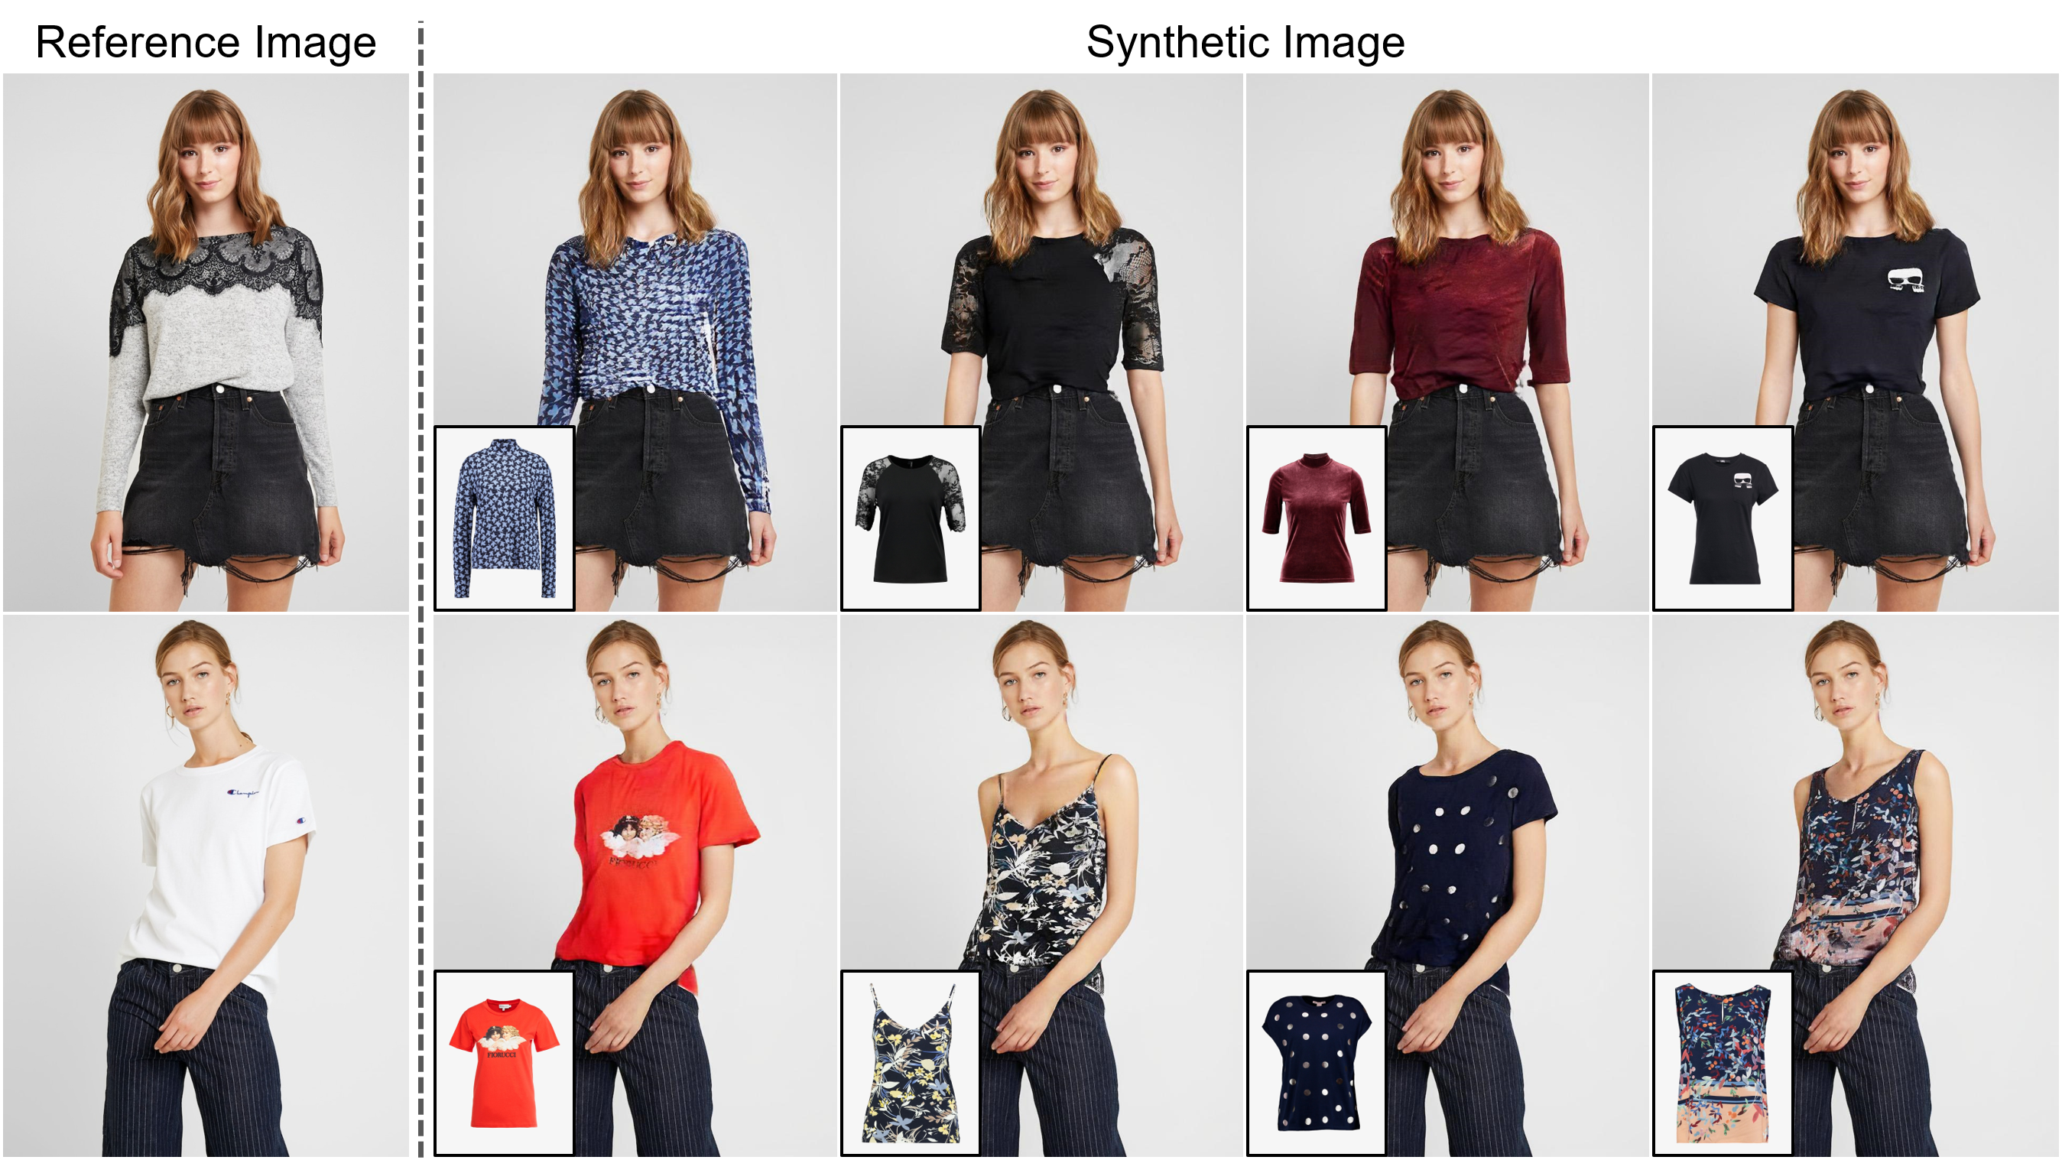
Lack of interactivity: Shopping online can be a passive experience, lacking the interactivity and engagement that customers often experience when shopping in-store.

Slide 6
Industrial Uses and Target Beneficiary
Fashion Industry: The target beneficiaries for a virtual try-on project in the fashion industry could be online shoppers. Virtual try-on technology can provide a more engaging and immersive shopping experience, allowing customers to try on clothes and see how they look before making a purchase.
Beauty Industry: Virtual try-on technology can also be used in the beauty industry to help customers test makeup products before buying them. Target beneficiaries could be people looking to try out different makeup looks without having to physically apply the products themselves.
Eyewear Industry: Virtual try-on technology can help customers try on glasses and see how they look before making a purchase. Target beneficiaries could be people with vision problems who need to buy glasses, but prefer to do so online.
Home Decor Industry: A virtual try-on project in the home decor industry could target homeowners who are looking to redecorate their homes. The technology can allow them to visualize how furniture and decor items would look in their homes before making a purchase.
Automotive Industry: Virtual try-on technology can also be used in the automotive industry to help customers see how different car models would look in different colors and configurations. Target beneficiaries could be car enthusiasts who are interested in customizing their cars.

Slide 7
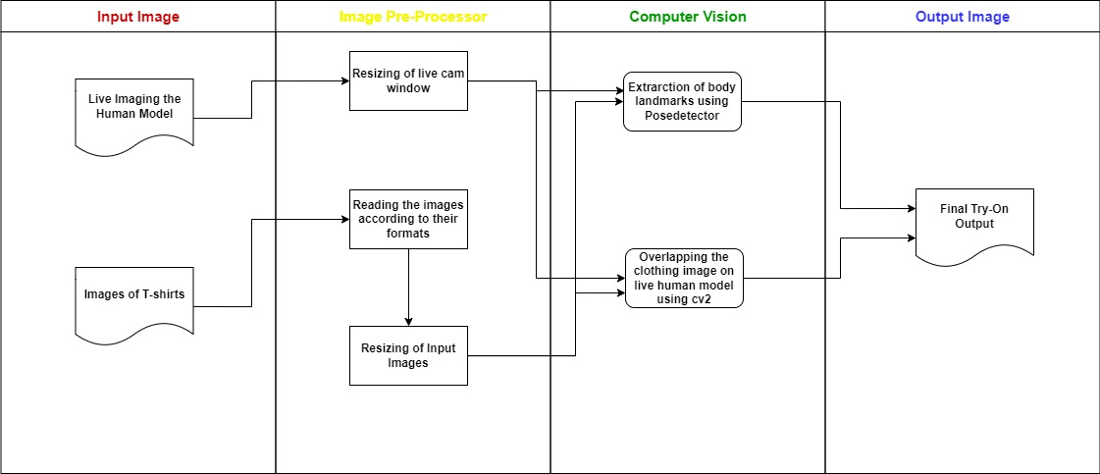
Basic Analogy Of the project
Analogy is we have a images of clothing items which we have to superimpose on the live camera capture of the user.

Slide 8
Ideology Behind The Project
The basic ideology of a virtual try-on project is to allow customers to virtually try on a product, such as clothing or accessories, before making a purchase. This is achieved by using advanced technology such as computer vision, augmented reality, and machine learning to create a realistic virtual representation of the product that can be superimposed onto a live image or video of the customer.
The basic ideology of a virtual try-on project is to allow customers to virtually try on a product, such as clothing or accessories, before making a purchase. This is achieved by using advanced technology such as computer vision, augmented reality, and machine learning to create a realistic virtual representation of the product that can be superimposed onto a live image or video of the customer.

Slide 9
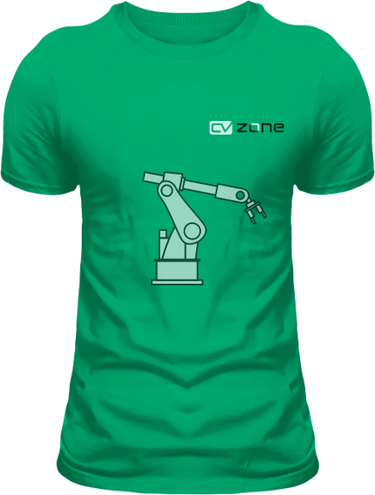
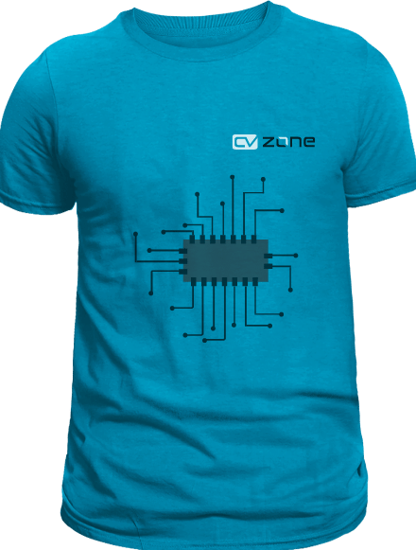
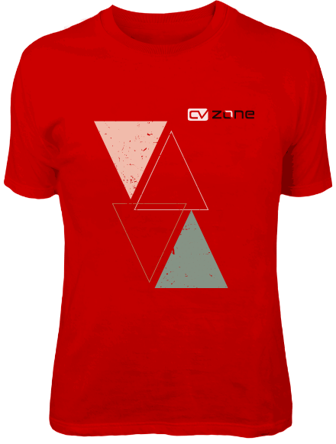
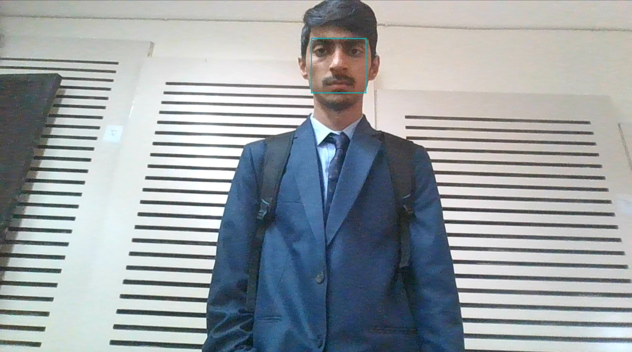
Building the Prototype
Inputs Provided:
Images of clothing items in .png format.
Live video capture of the user using the webcam of the device.

Slide 10
Processing Steps:
Plotting of Landmarks on user: Using the face-mesh model that uses 33 landmarks in total we plotted these landmarks to properly position the image of clothing item.
Resizing of images: We have resized the image of clothing item according to the ratio of distance between the landmarks 11 and 12 and width of the image.
Locating the points to overlaying the image: The positional coordinates for plotting of images on the live camera capture are calculated by applying mathematical calculations.
Superimposing the images: The images of clothing items are superimposed on the live camera capture using the cvzone.overlayPNG function of cvzone library.
Defining the image changing buttons: The image changing buttons are defined using overlaying the button images on live camera capture and setting response time for changing the image.

Slide 11
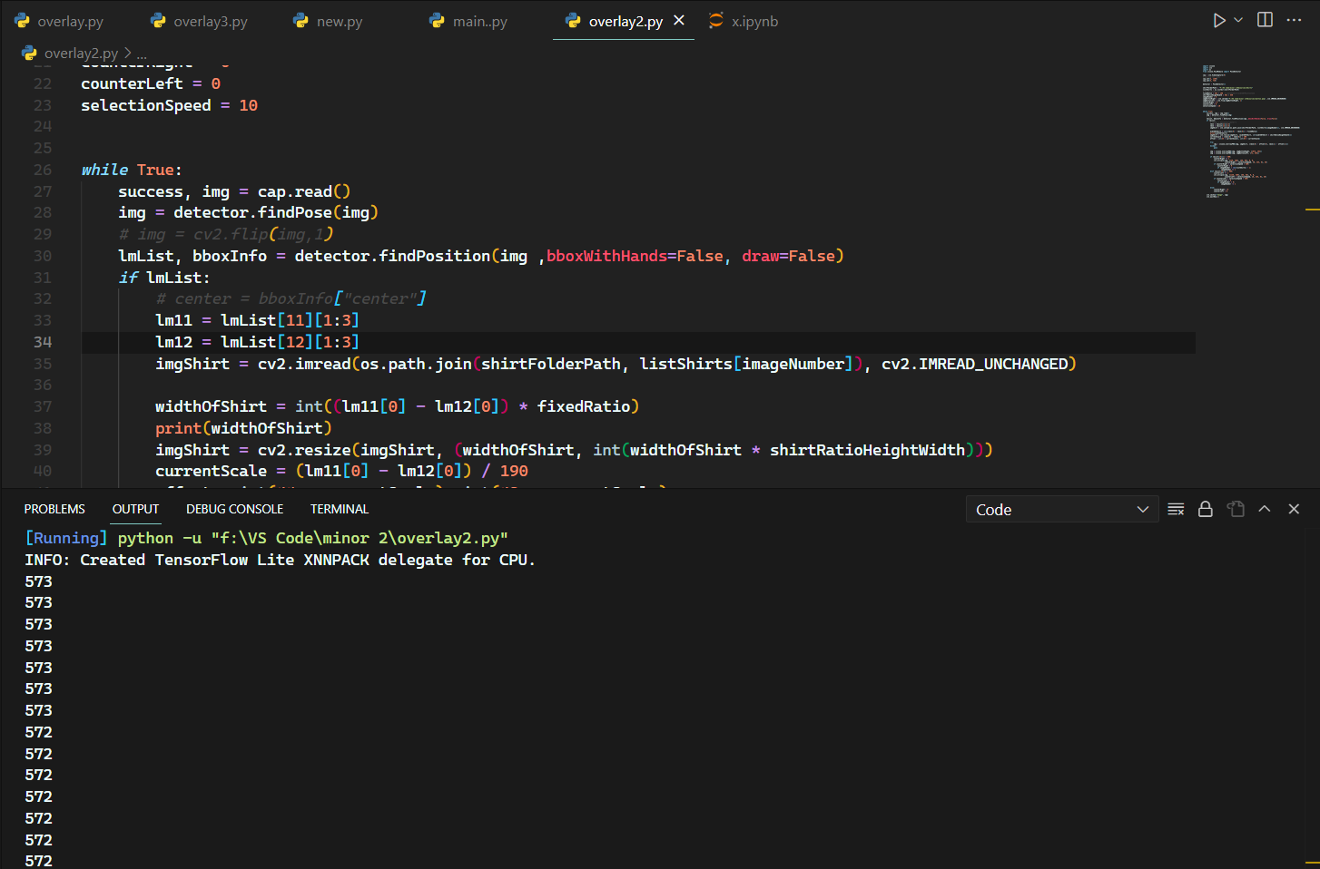
Outputs:
Terminal output:

Slide 12
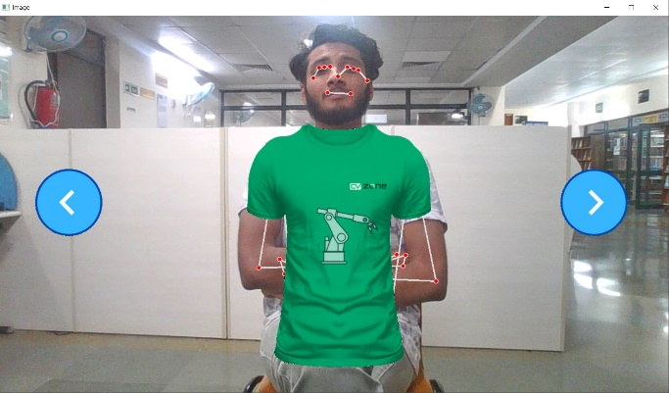
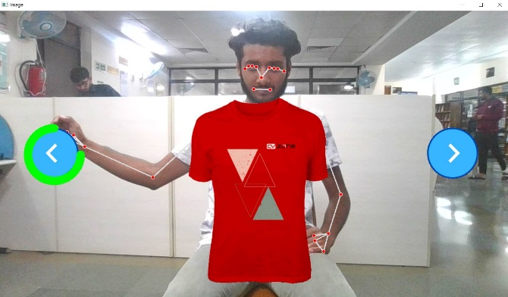
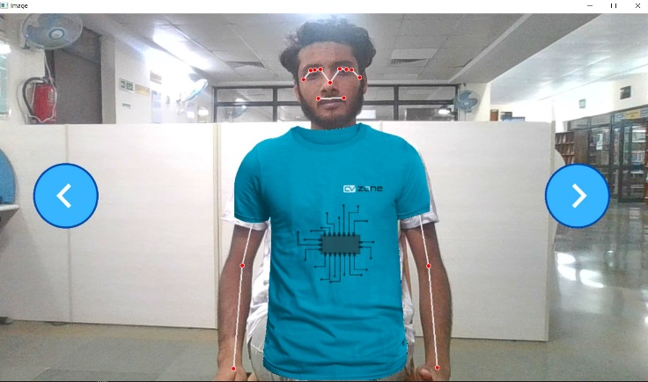
Live Demo For Prediction
We can use our live camera capture to check how the clothing item is looking on us.

Slide 13
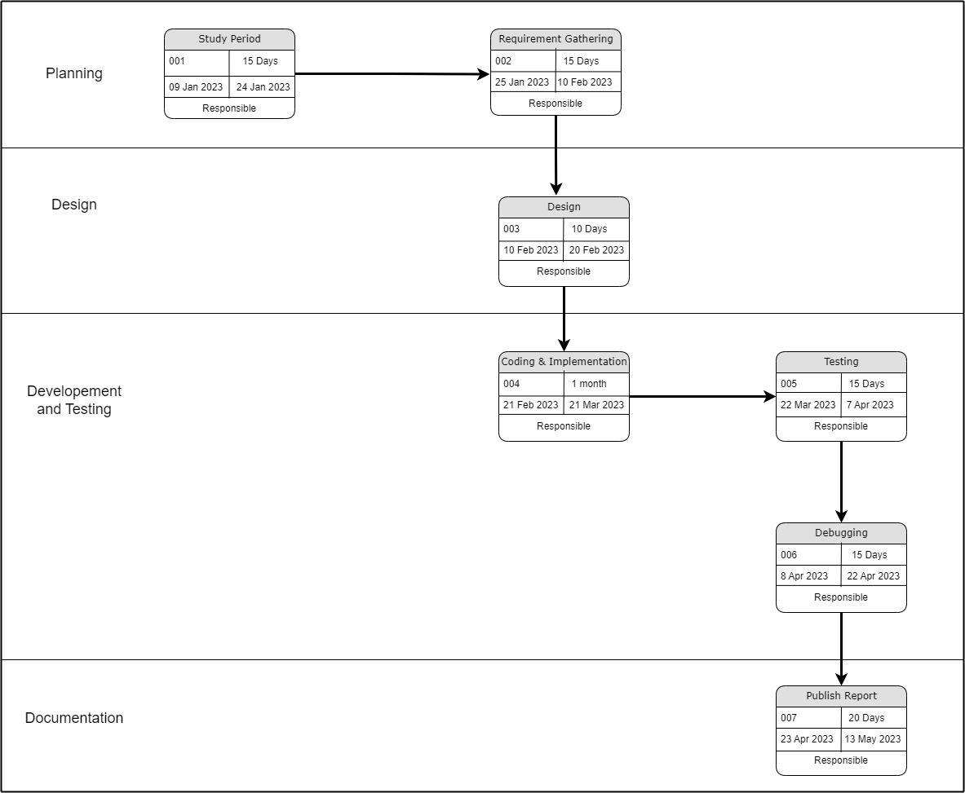
Pert Chart

Slide 14
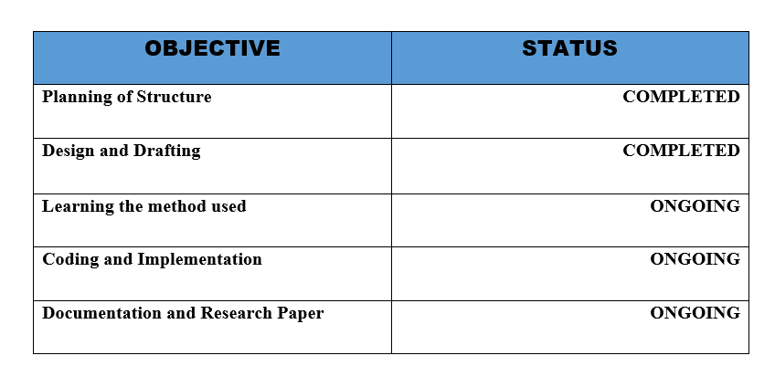
Attained Deliverables

Slide 15
SWOT:
Strength :
Current need of the market
Useful in managing other AI application
Weakness :
Fault intolerant.
Accuracy may depends on the accent of the user.
Opportunity :
A new boost for fashion industry.
Boon for product based companies
Threat :
Some researches are ongoing to achieve this objective more efficiently.

Slide 16
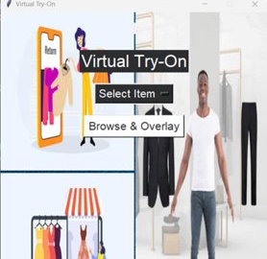
Changes Made After Mid-Semester Assessment
Making a user friendly interface :
it's important to make sure users can easily use virtual try-on. Designing a simple and clear interface that helps users try on virtual products without making them feel confused or giving them too many options to choose from.

Slide 17
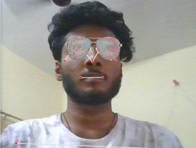
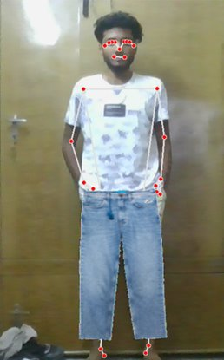
Introducing new try- on objects Eyewear and Legwear

Slide 18

Reducing Error in fitting :
Upper body clothing : Making the ratio change according to user size reduced error much greater extend and increasing Accuracy. Present Error in fitting range 20% to 10%
Error = |E_overlap - A_overlap|.
Where A_overlap = area objects overlap by
E_overlap = the expected overlap area

Slide 19
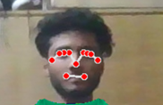
Eye wear Accuracy: Accuracy of Eyewear is very high around 90% due to 9 landmarks used to fit eye wear on the person making the accuracy high
Leg wear: Leg wear still faces the same problem as the upper wear faced but is still better then than what Upper wear Accuracy was at start. This problem can be solved using a realistic model

Slide 20
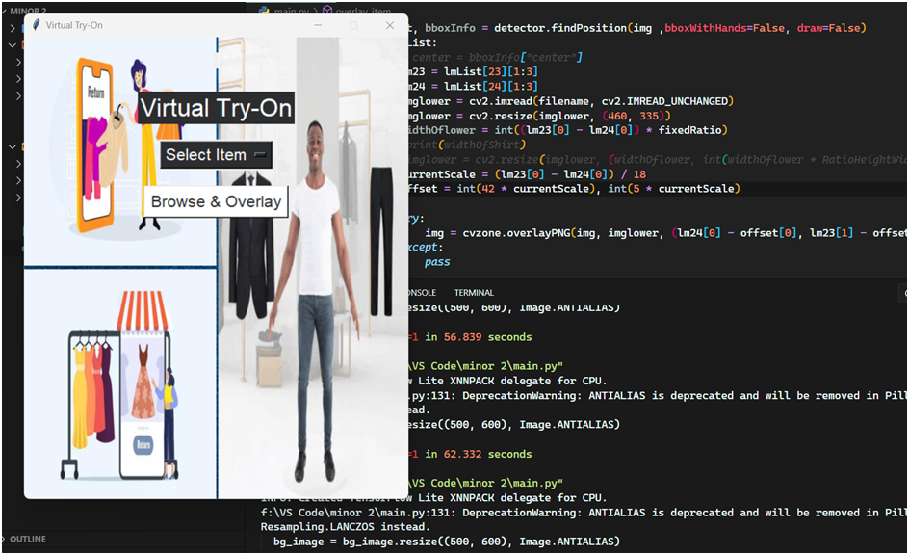
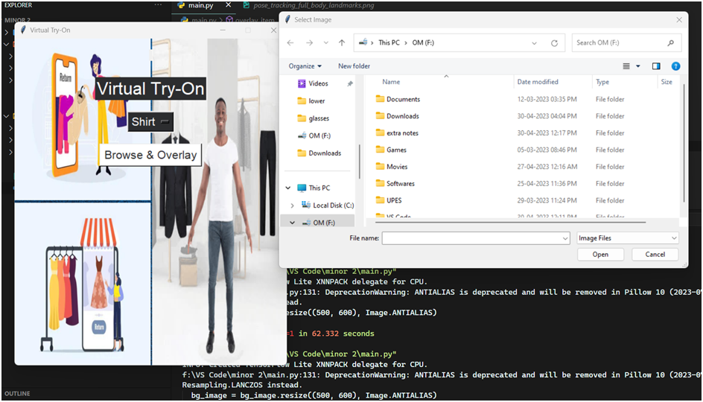
Making it easier to introduce new clothing item that come Upper wear, leg wear and eye wear

Slide 21
Using outline around the person
Outline idea at start feel feasible and good but when implemented had a major set back
1. Outline when created around the person were to be give increased the size of the person making it inaccurate
2. There should be space between arms and body for it to understand or the model will see arms as upper body and size of uppers that are to be checked will increase
3. If whole person is not visible or the point we use to identify a person is not visible then the model will not work
Overall, What we learned from implementing outline model is that the good at capturing the person movement and some we also good at detecting specific body parts

Slide 22
Challenges we still face
Accuracy: Though the accuracy has improved a lot from the previous attempt it is still not that high for a perfect fit on any online platform. Factors such as lighting, camera quality, and the shape and size of the user's body can all affect the accuracy of the virtual try-on experience
Only PNG: png image as it allows the items to be displayed without any background, and is the only acceptable format that clothes and other wearable items can be used in our model
Realistic movement: Another key issue is ensuring that the clothing moves realistically with the virtual model's body movements. This requires accurate modeling of fabric physics and how it interacts with the virtual model's body.
Variability of body shapes: People come in all shapes and sizes, and clothing must fit well on all of them. The virtual try-on project should take into account the variability of body shapes and sizes and provide solutions that work for everyone.
Realistic appearance: Clothing textures, colors, and lighting must be accurately represented in the virtual environment to create a realistic and convincing experience for the user.

Slide 23
Conclusions
The field of virtual try-on technology is still relatively new, and researchers are still exploring the best techniques and methods for accurately simulating the appearance of clothing on a virtual model. One of the main challenges is accurately capturing the shape and movement of clothing, which can vary greatly depending on the material, cut, and style.
Moreover, there are also challenges in accurately simulating the appearance of clothing on different body types and skin tones, which requires a large and diverse dataset of virtual models.
However, virtual try-on technology has great potential to revolutionize the fashion industry and improve the online shopping experience for consumers. it can reduce the need for returns and improve overall customer satisfaction.
To improve the accuracy of virtual try-on technology, researchers can work on developing more advanced 3D modeling and animation techniques. They can also collect more diverse and comprehensive datasets of virtual models to ensure that the technology works well for a wide range of users.

Slide 24
References:
https://ieeexplore.ieee.org/stamp/stamp.jsp?tp=&arnumber=8719115
https://arxiv.org/ftp/arxiv/papers/1810/1810.10148.pdf
https://openaccess.thecvf.com/content_cvpr_2018/papers/Han_VITON_An_Image-Based_CVPR_2018_paper.pdf
https://www.youtube.com/watch?v=6C7R24-Ze10

Slide 25
Thank You

